Slide 1
ROBOT DESIGN JUDING Without A ROBOT Game Table
Seshan brothers

Slide 2
No TABLE in judging. Now what?
Many regions around the world, including World Festival, are moving towards eliminating the FIRST LEGO League game table in the Robot Design judging room.
The judges provide a laminated image of the field for teams to refer to
While this may seem like an alarming change for existing teams, it is not
Robot Design judging focuses on process, not the performance of the robot
You should be able to talk to the judges about your engineering design process, and how you came up with your ideas and decisions, without the use of the table
This lesson provides several questions that your team may want to answer as part of your Robot Design Executive Summary (RDES). Be sure you cover all aspects of the rubric (Mechanical Design, Programming, Strategy & Innovation).

Slide 3
DESCRIBE YOUR ROBOT
How did you come up with the design for the base robot? Did you start with an existing design (your last year’s robot or something from the Internet/book)?
Experienced judges can recognize standard designs. Therefore, always cite your sources.
Did you test your design(s) before picking it?
What are the features on it? Why?
What features on the robot make it sturdy and balanced?
What features are you proud of?
Did the design change over time?
Low center of gravity
Two well-separated, aligned color sensors
Outer walls that support wheels
Wall riding wheels
Level construction – notice caster is level with drive wheels
Color sensors well in front of driving wheels

Slide 4
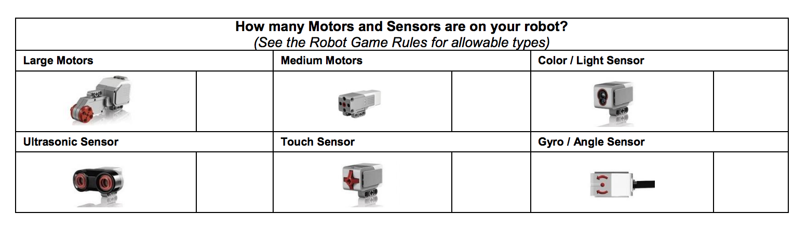
DESCRIBE THE SENSORS & MOTORS
How many motors and sensors do you use? Which ones?
Why did you chose to use those? Which missions do you use them on?
How do you use sensors and do you use them in any novel way?

Slide 5
EXPLAIN YOUR TEAM’s STRATEGY
How did you come up with your strategy?
How did you decide on which missions to accomplish?
Use the laminated sheet provided in judging or create a diagram ahead of time to show the robot’s paths and explain your strategy

Slide 6
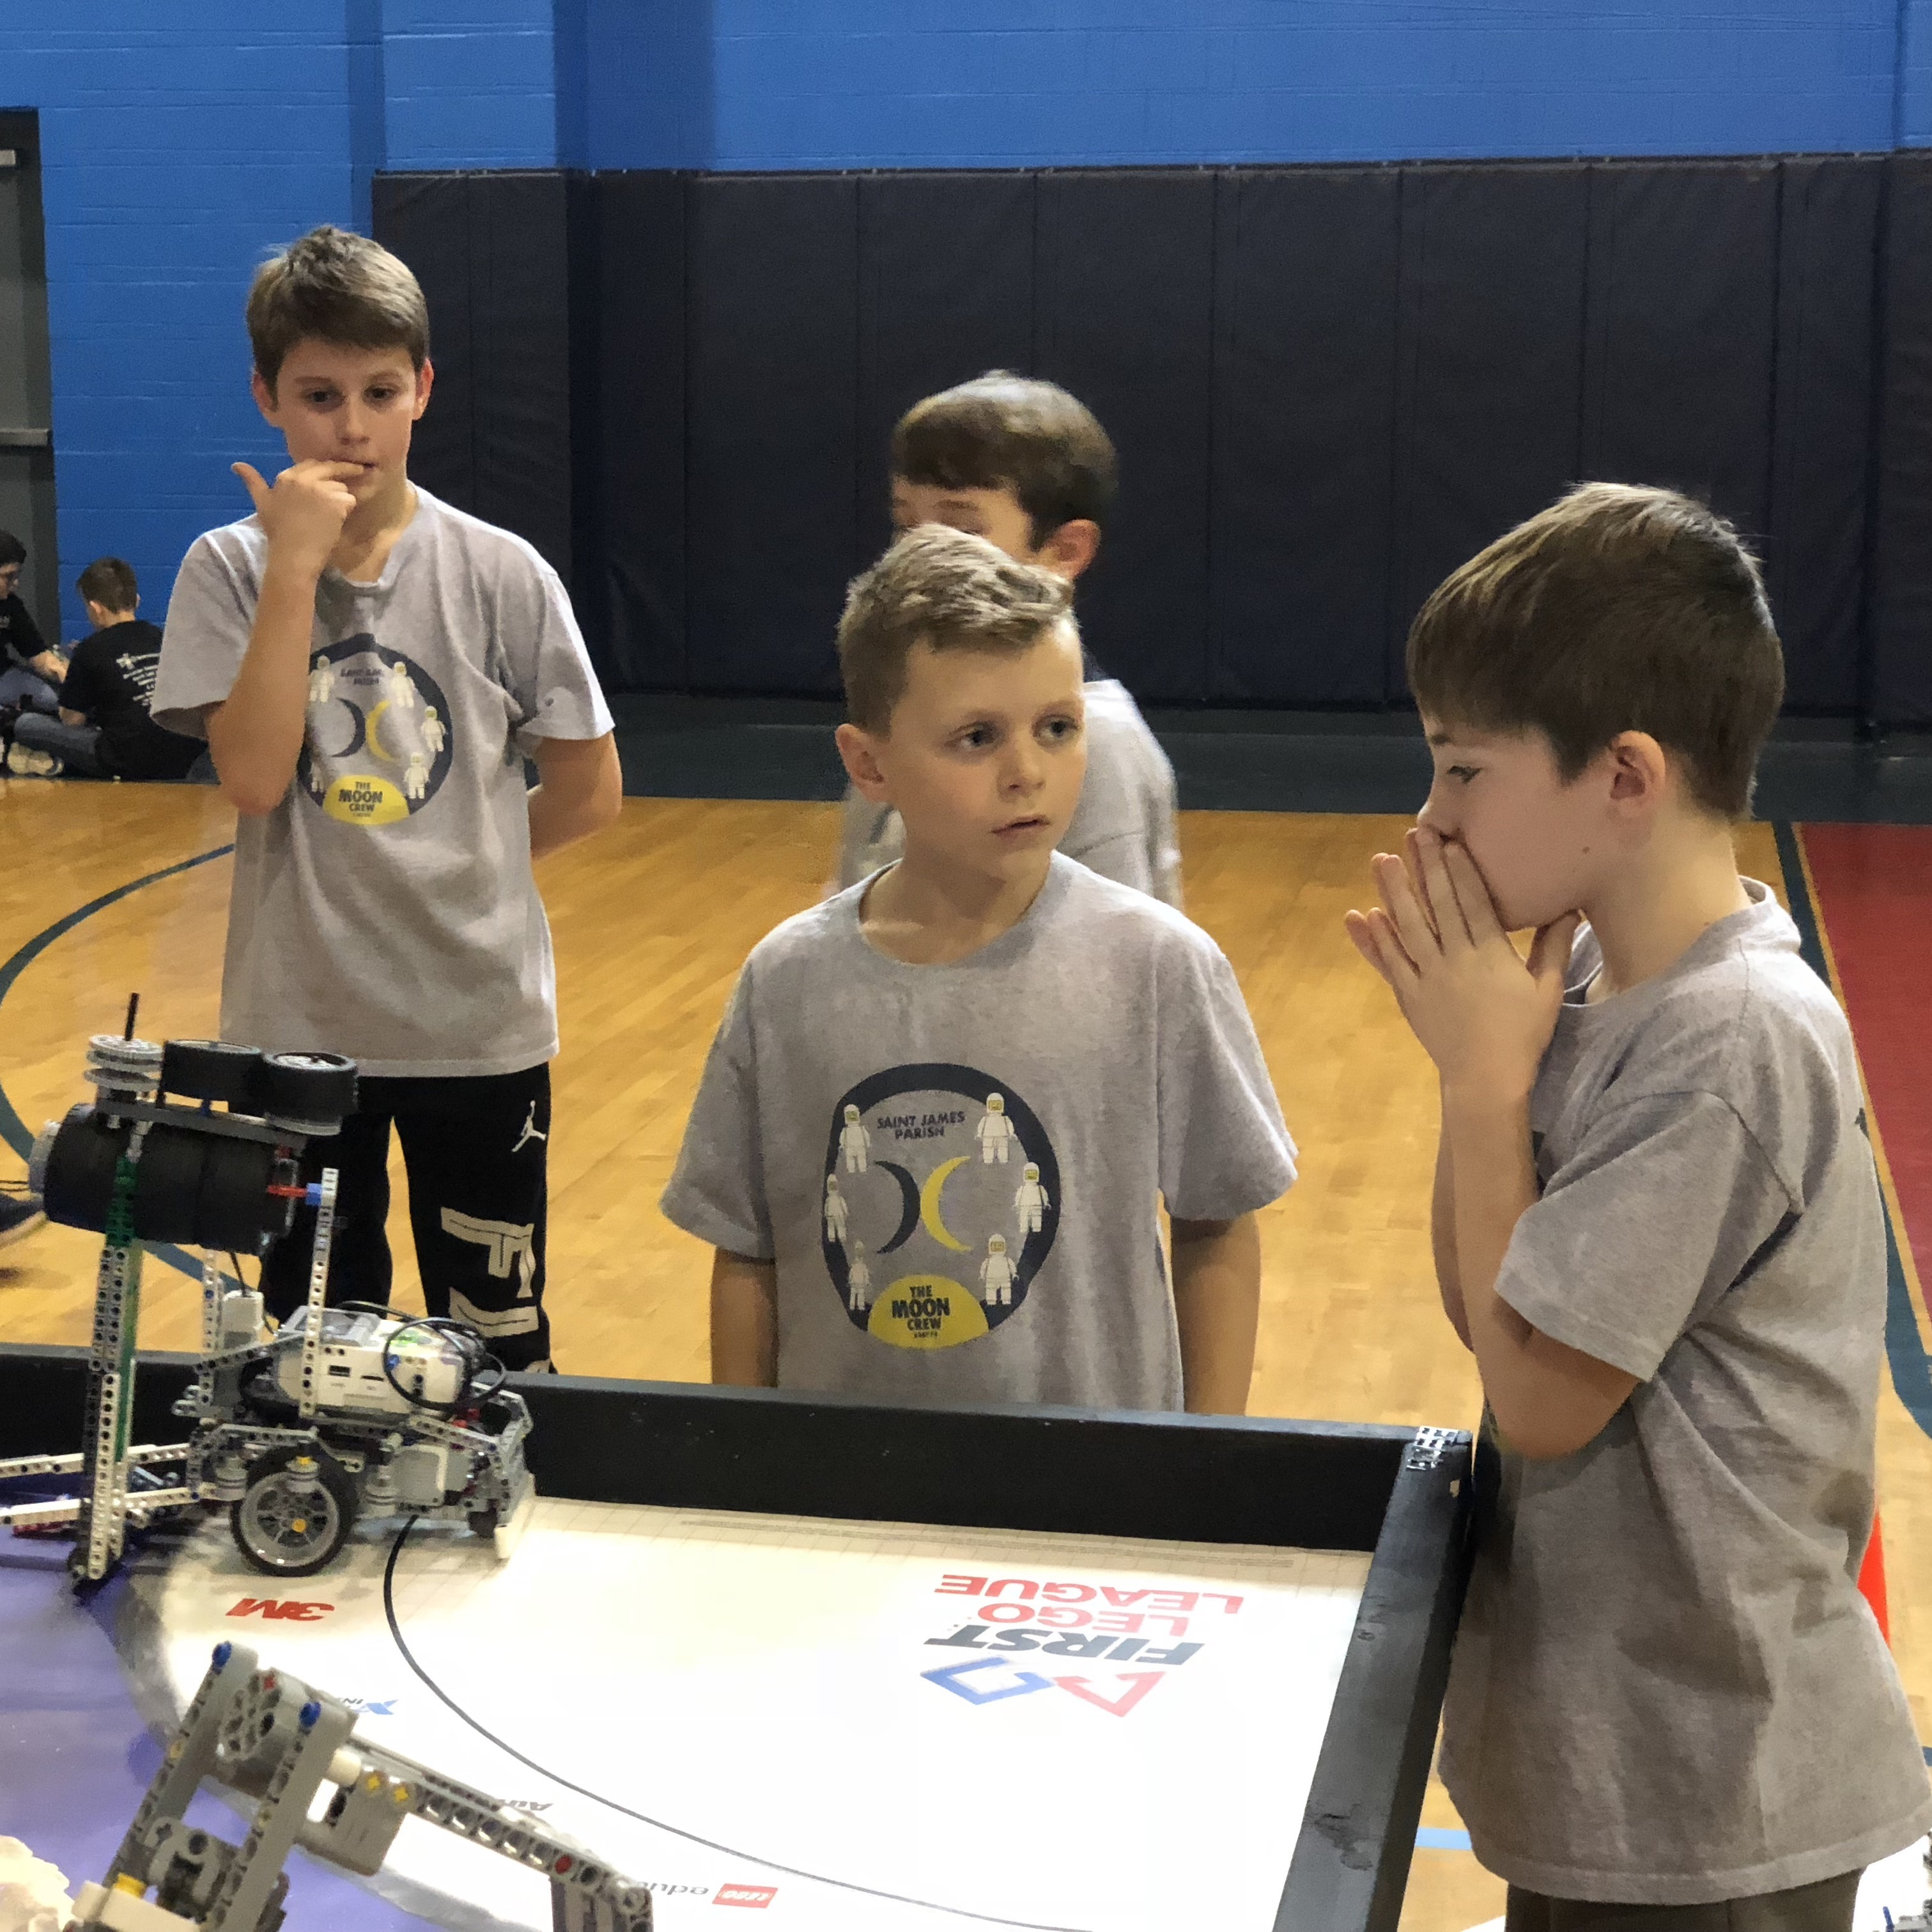
EXPLAIN your ATTACHMENT DEVELOPMENT
How do you solve the missions?
How did you come up with that solution?
How did that solution change over time?
Do you solve a particular mission in an unusual way?

Slide 7
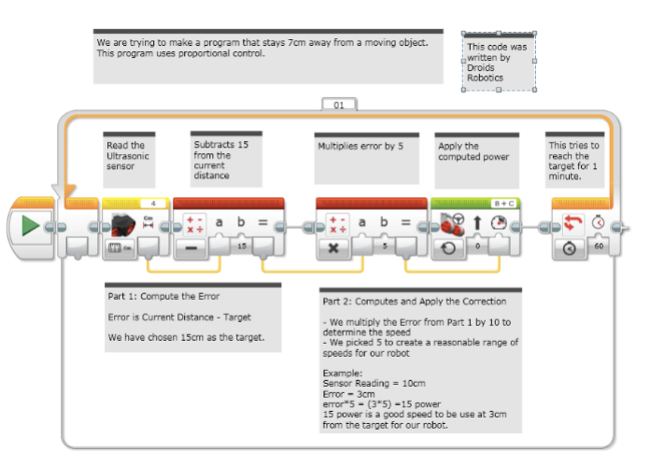
Explain your PROGRAMMING
Since the table is not in the room, you cannot rely on “showing your programs in action” to explain automation and consistency
Therefore, learn to explain your code clearly
No matter what programming language you used, you should be able to communicate your programming techniques to the judges
Make sure you have pseudocode and comments
You should be able to explain your code on a laptop or using a printout

Slide 8
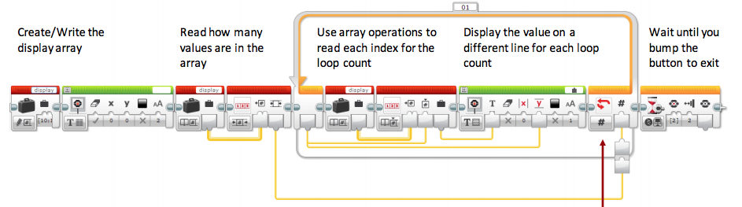
EXPLAIN YOUR PROGRAMMING
Explain how your code is organized
How do you know what a block is doing? Are there comments?
Do you use My Blocks (or equivalent Functions in another language)?
How do you keep track of changes to the code?
Explain any interesting algorithms your team came up with
Explain how your code helps your robot be more reliable. What coding techniques/sensors do you use?
Again, experienced judges will recognize code from others
If you used code from some source, always remember to cite it, explain how it works, and how your team modified or used it

Slide 9
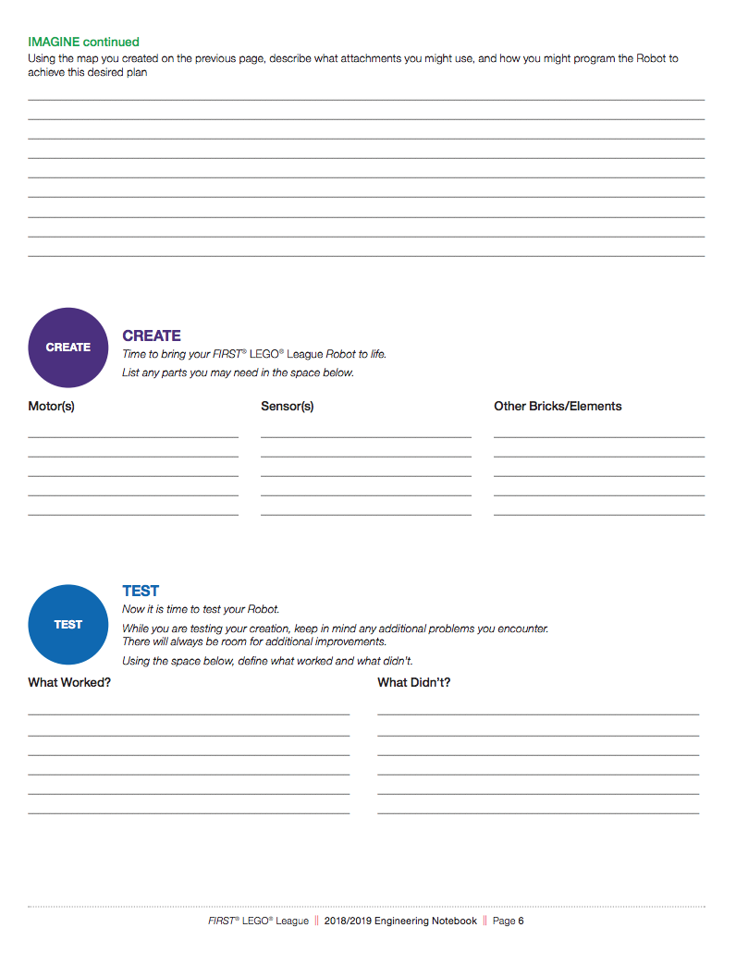
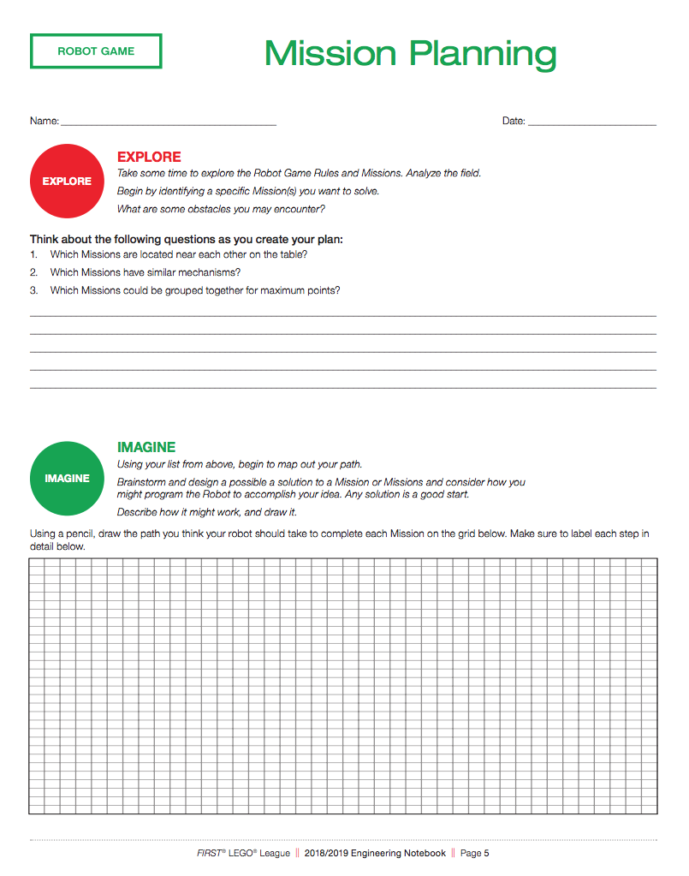
NOT REQUIRED, BUT HELPFUL
Consider having a team Engineering Journal to document your process
Consider sharing any testing your team may have done
Some teams create a poster board with examples to point to
Consider printing out your code as well as pictures of your development process and current robot
Consider leaving a one-page summary of your presentation with your judges to help them remember your team (include a picture of your team, your robot and the key information you want to communicate)

Slide 10
Credits
This tutorial was created by Sanjay Seshan and Arvind Seshan
More lessons at www.ev3lessons.com and www.flltutorials.com
This work is licensed under a Creative Commons Attribution-NonCommercial-ShareAlike 4.0 International License.

